Slide 1
McFat Web Application Plan
Jens Mellberg, Matteo Milos,
Bastien Pery, Henrikki Helander

Slide 2
Our plan
Web app that will help find the nearest McDonalds restaurant
Also give us other important information
Calorie count
Price comparisation
Location

Slide 3
Features
Web site shows the nearest McDonalds restaurant
Shows prices in different countries by drawing dynamic graph
Menu picker, where you can choose etc. (cheapest, fattest... whatever)
Possibility to add more features too, if we have time

Slide 4
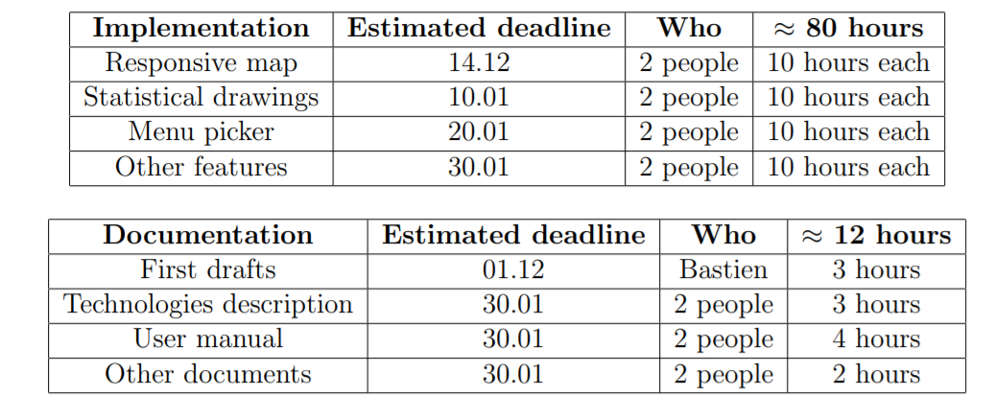
Road map and roles

Slide 5
Any questions?
Thank you!

